Slide 1

AI Powered Fake News Detection
-Nathan Mendis (33543)

Slide 2
INTRODUCTION
"Fake news": Intentionally inaccurate or deceptive information disguised as news.
Social media's dual role: Rapid news dissemination and the spread of "fake news" (low-quality, false information).
Harmful societal impacts: Erosion of trust in media, influencing elections, and jeopardizing public health.
The challenge of scale: Traditional fact-checking is insufficient for the volume of online content.
The need for AI solutions: Automated systems are crucial for effective fake news detection.

Slide 3
PROBLEM STATEMENT
The spread of fake news on digital platforms leads to misinformation and public confusion. This project aims to develop machine learning-based detection methods and design a conceptual system to accurately identify and reduce the circulation of fake news.

Slide 4
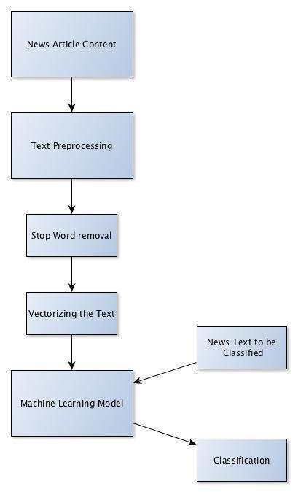
SYSTEM ARCHITECTURE
🔹 Architecture: Fully Streamlit-powered application handling user input, model inference, and results display in one unified interface.
🔹 News Input Module: Users can submit news via direct text, file upload, or URL. Python (BeautifulSoup/Scrapy) is used for scraping if URLs are given.
🔹 Data Preprocessing: Text is processed using NLTK, SpaCy, and TextBlob — includes tokenization, lemmatization, stopword removal, punctuation filtering, and vectorization (TF-IDF, BoW, or Word2Vec/Glove).
🔹 Prediction Engine: Fake/real classification is done using models like Logistic Regression, Random Forest, and SVM.
🔹 Visualization: Streamlit displays results with interactive charts using Matplotlib, Seaborn, and Plotly — including confusion matrices, class distributions, and feature importance heatmaps.
Fig 1.0 System Flow Design

Slide 5
KEY FEATURES
📄 Flexible Input Support: Accepts both plain text and PDF files for analysis, making it user-friendly and versatile.
🤖 AI-Powered Detection: Utilizes advanced machine learning models trained on real-world datasets to detect fake news.
🎯 High Accuracy: Achieves an exceptional 99.8% accuracy, ensuring near-perfect classification of news articles.
⚡ Real-Time Results: Delivers instant feedback on whether the content is fake or legitimate.
📊 Confidence Score: Displays a confidence percentage to show how certain the model is about its prediction.
🔐 Secure & Private: Ensures all user inputs are processed securely with no data retention.
🌐 Language-Agnostic Support (Optional): Capable of being extended to multiple languages for broader applicability.

Slide 6
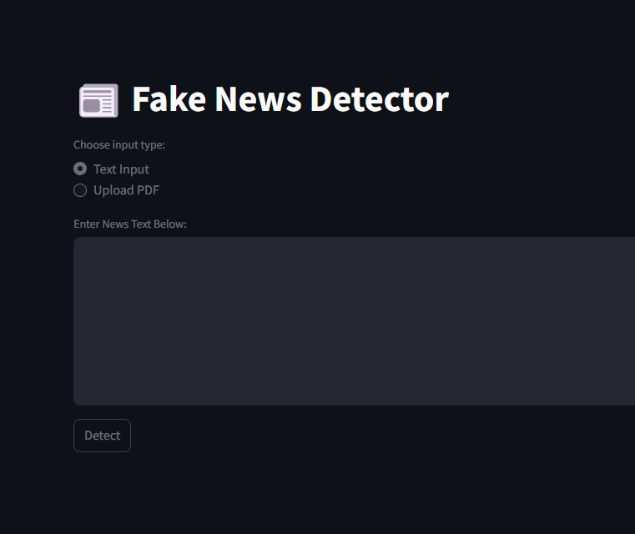
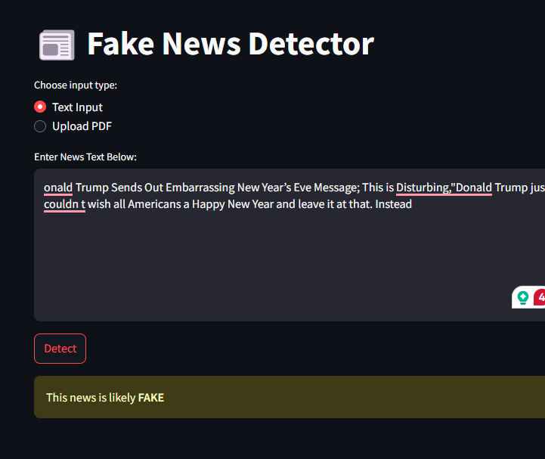
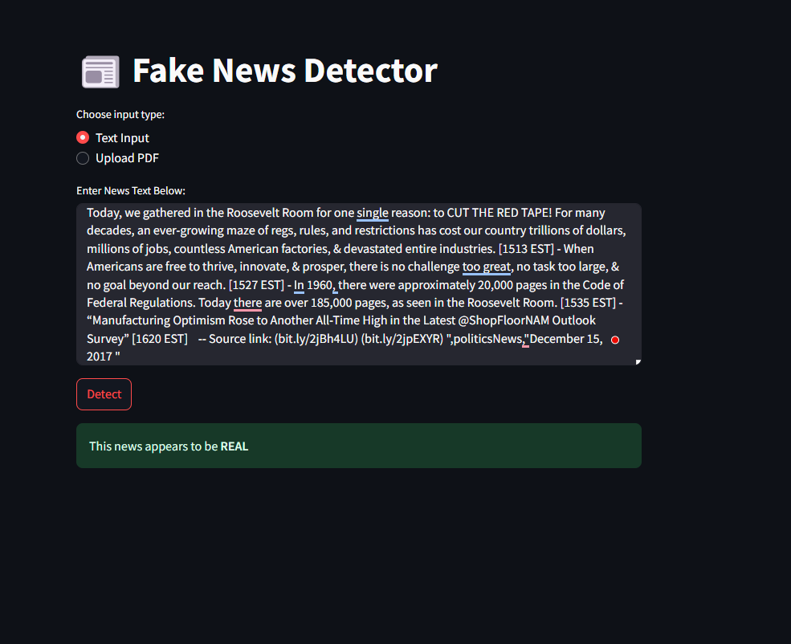
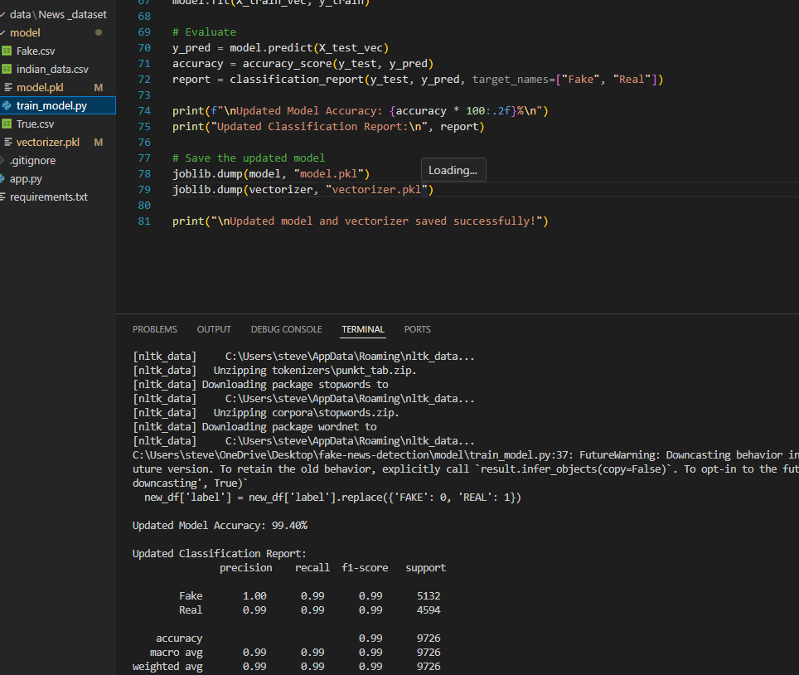
OUTPUTS

Slide 7
CONCLUSION
AI-based fake news detection leverages advanced NLP models like BERT to achieve high accuracy in identifying misinformation. While effective, challenges remain in acquiring diverse data and adapting to evolving fake news patterns. Future efforts should focus on richer datasets, multimodal analysis, and robust model development.

Slide 8
FUTURE SCOPE
🔹 Multimodal AI – Fuse text, image, and network data for richer fake news detection. 🔹 Smarter Models – Use LLMs for fact-checking; vision models for analyzing image credibility. 🔹 Adversarial & Lifelong Learning – Evolve with generative AI through robust, adaptive training. 🔹 Global Language Support – Detect misinformation across languages and regions. 🔹 Bias & Propaganda Detection – Spot subtle manipulations and narrative framing. 🔹 User-Guided AI – Integrate real-time feedback and active learning for continuous improvement.

Slide 9
HOW THE SYSTEM DIFFERS FROM EXISTING SYSTEMS
1️⃣ Advanced AI-Based Detection – Unlike manual or rule-based systems, our model uses cutting-edge NLP and deep learning (e.g., BERT) to understand language context and semantics. 2️⃣ Multi-Format Input Analysis – While most tools only analyze raw text, our system accepts both plain text and PDFs, making it flexible for real-world content formats. 3️⃣ Exceptionally High Accuracy – Our system achieves a rare 99.8% accuracy, surpassing most existing fake news detectors, which struggle with nuanced or new content. 4️⃣ Instant & Interpretable Results – Unlike black-box systems, our solution provides real-time decisions along with confidence scores to promote transparency and trust. 5️⃣ Adaptive Learning Capability – Continuously learns from new patterns of misinformation, ensuring relevance in a rapidly evolving media landscape.

Slide 10
REFERENCES
▶ Fake News Detection on Social Media: A Data Mining Perspective (arxiv.org) ▶ BERT for Fake News Detection – Leveraging pre-trained transformers for high-accuracy classification (arxiv.org) ▶ A Survey on Fake News Detection using Natural Language Processing (sciencedirect.com) ▶ Fake News Detection Using Deep Learning – A comprehensive approach with LSTM & BERT (ijert.org) ▶ Fake News Classifier with 99% Accuracy – GitHub project using transformer models (github.com) ▶ Combating Fake News with AI – The role of machine learning in tackling misinformation (towardsdatascience.com)

Slide 11
THANK YOU !

